Slide 1
Dell’s Popularity in Social Media
Lina Xiang
Gong Zhang
Lei Zhang
Xiyu Zhu

Slide 2
Agenda
Introduction
Market Analysis
Data Sources
Data Analysis
Limitations
Findings

Slide 3
Introduction - Dell
Dell
Headquarter: Round Rock, TX, USA
Founded: 1984
Revenue: $62.07B – 2012
Employees: 110,000
Number 147 in the Fortune 500 - 2012
Products: Desktop PCs, Mobility, Software & Peripherals, Services, Storage, Servers and Networking

Slide 4
Introduction - HP
HP
Headquarter: Palo Alto, CA, USA
Founded: 1939
Revenue: $120.357B – 2012
Employees: 311,610
Number 31 in the Fortune 500 - 2012
Products: Notebooks, Desktops, Workstations, Printing, Services, Software, Finance

Slide 5
Introduction – Lenovo
Lenovo
Headquarter: Morrisville, North Carolina, USA
Founded: 1984
Revenue: $29.57B – 2012
Employee: 27,000
Number 370 in the Fortune 500 - 2012
Products: Notebook, Desktop, MIDH (Multimedia, Internet and Digital Home)
Notes:
Acquired IBM personal computer business in 2005

Slide 6
Introduction – Apple
Apple
Headquarter: Apple Campus, 1 Infinite Loop, Cupertino, CA, U.S.
Founded: 1976
Revenue: $156.508B – 2012
Employee: 72,800
Number 55 in the Fortune 500
Products: Desktop, Protables, Ipod, Iphone, Ipad

Slide 7
PC Market Share by Year
Note: 15.9% → 10.7%, ↓32.7% in 7 years

Slide 8
PC Market share in Q4-2012

Slide 9
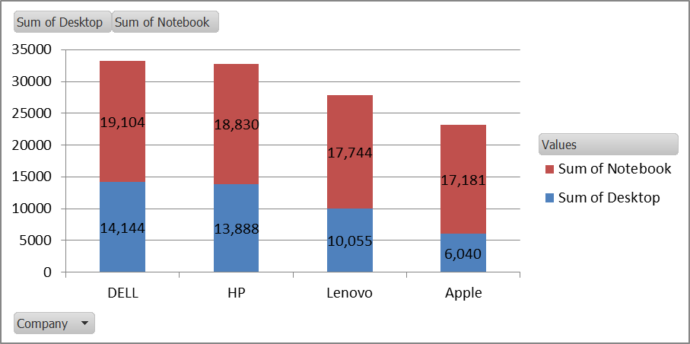
PC Market by Revenue - 2012

Slide 10
Objectives
Dell’s popularity in the social media comparing with competitors.
Identify possible weaknesses and opportunities for Dell’s future business.

Slide 11
Data Source - Twitter
12 hours real-time tweets mentioning company and PC product brands
DELL: dell, Inspiron, XPS, Alienware, Latitude
HP: HP, Pavilion, ENVY, Elitebook, Hp2000, Spectre
Apple: MacAir, Macbook
Lenovo: Lenovo, Thinkpad, Ideapad, Essential

Slide 12
Data Source - YouTube
One official company channels related to PC product
Channels: Dell, HP, Apple, Lenovo
Subscribers
Video Views
Video Comments

Slide 13
Data Analysis

Slide 14
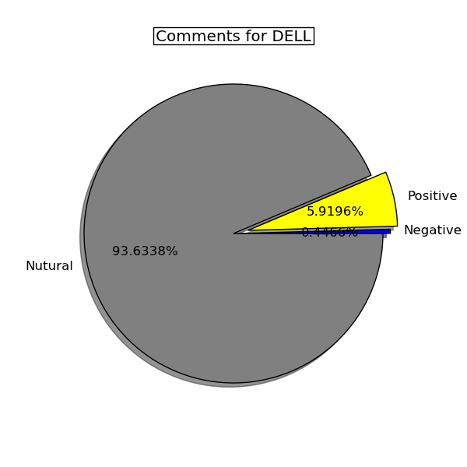
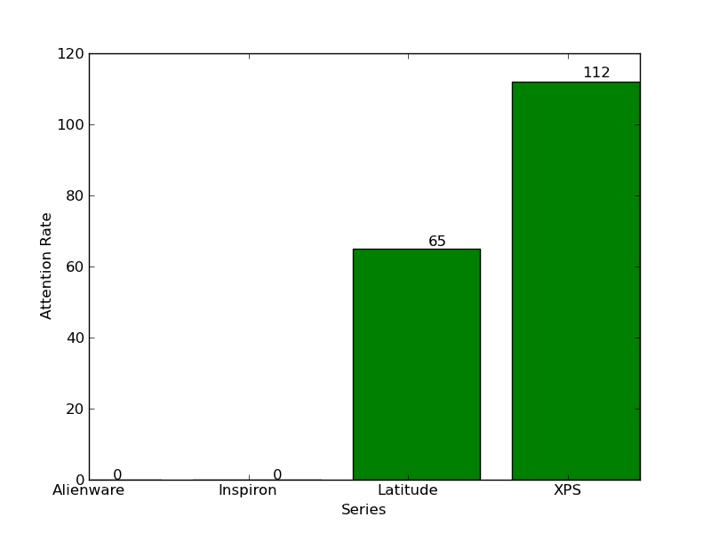
Popularity by Mention @twitter - Dell
Notes:
Data retrieving for Inspiron and Alienware was not successful.

Slide 15
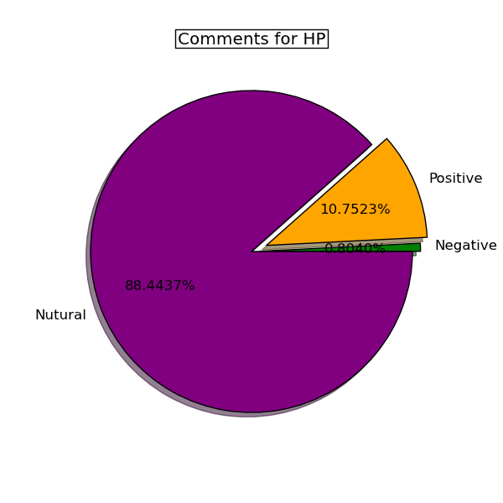
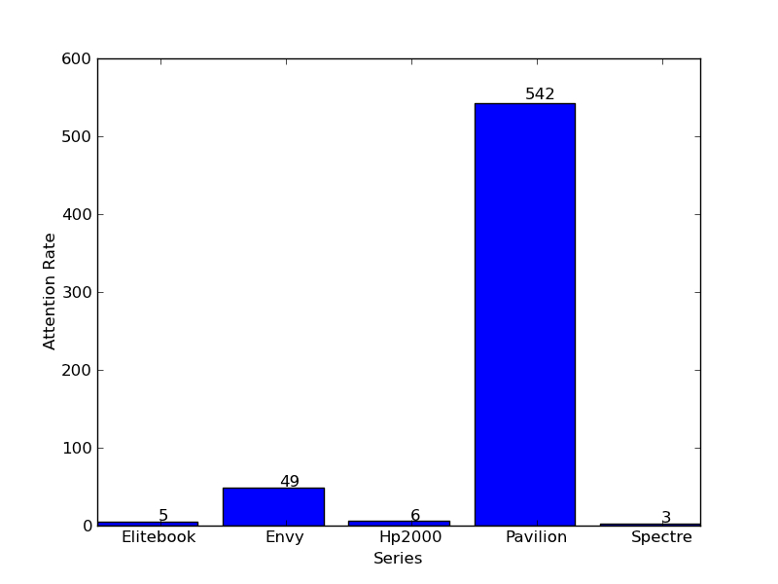
Popularity by Mention @twitter - HP

Slide 16
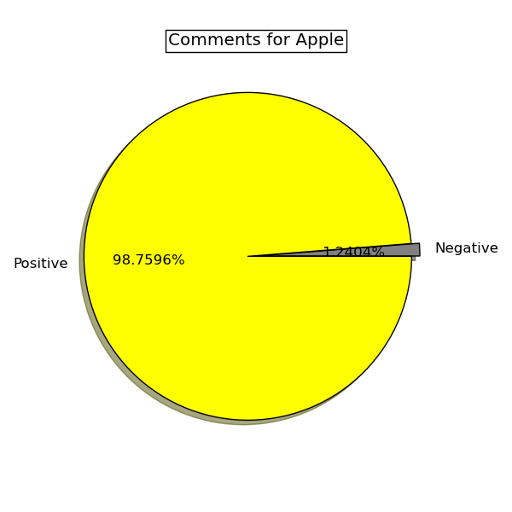
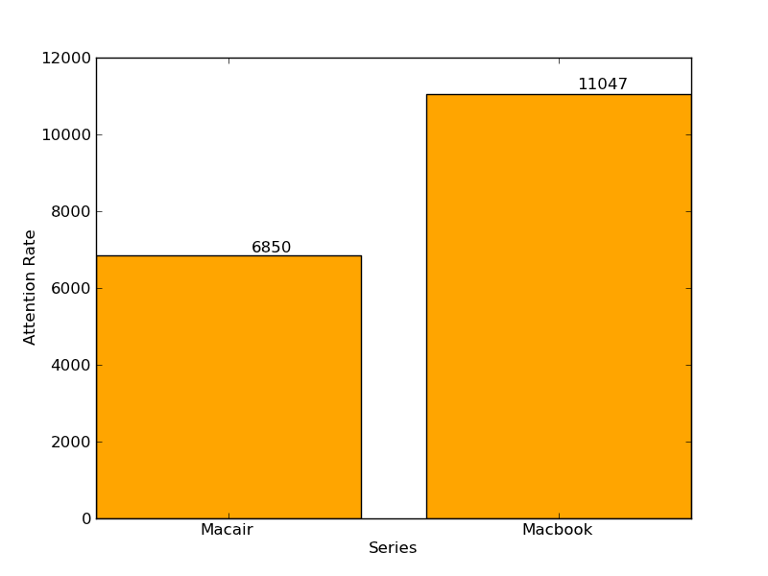
Popularity by Mention @twitter - Apple

Slide 17
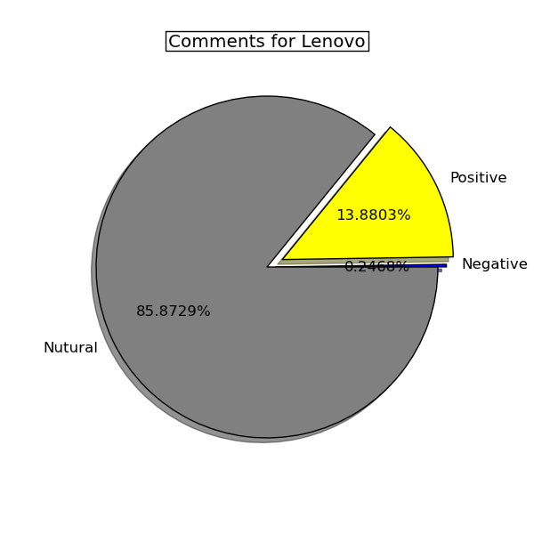
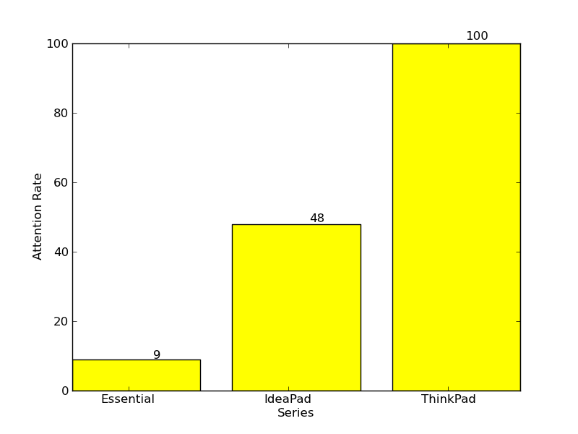
Popularity by Mention @twitter - Lenovo

Slide 18
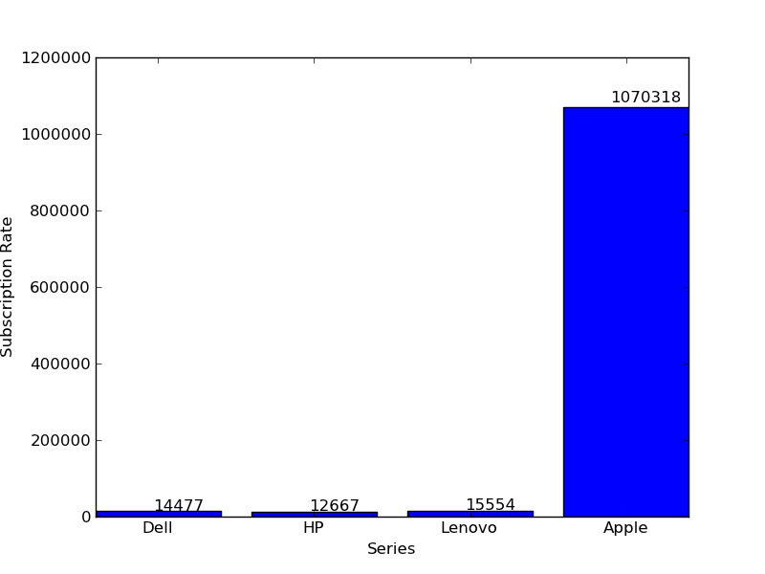
YouTube Popularity - Subscribers

Slide 19
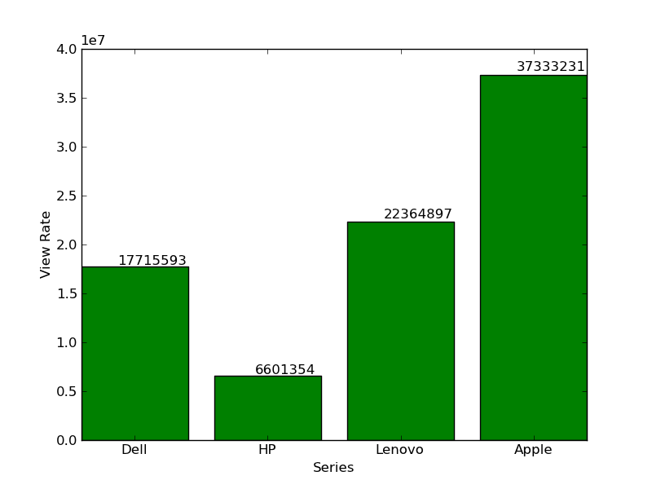
YouTube Popularity - Total Video Views

Slide 20
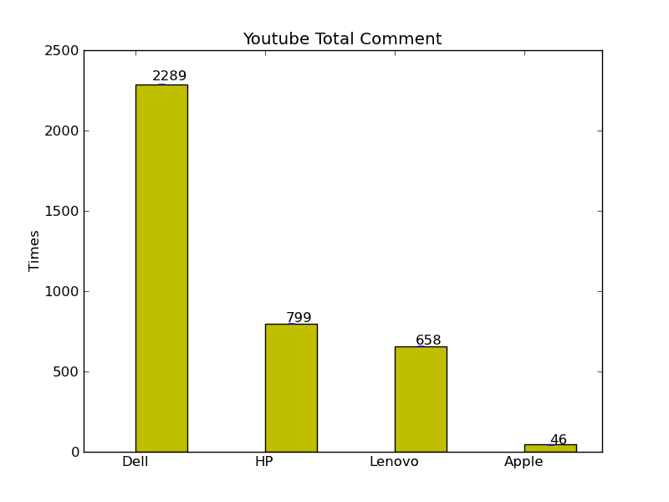
YouTube – Total Published Video

Slide 21
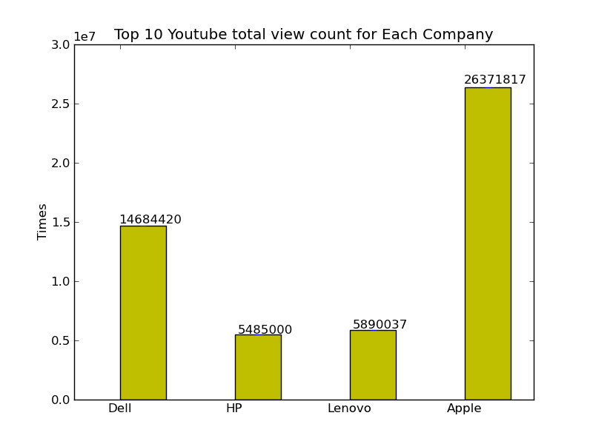
YouTube – Views of Top 10 viewed video

Slide 22
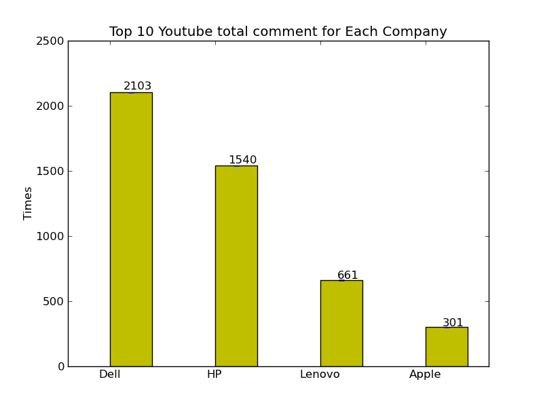
YouTube – Comments of Top 10 viewed video

Slide 23
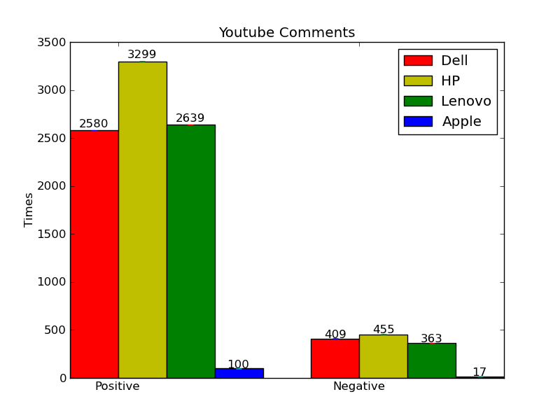
YouTube – Top 100 video Comment Sentiment Analysis
13.68%
12.12%
12.1%

Slide 24
Limitations
Key words selection
HP means “Hewlett-Packard”?
Focus on PC products?
Twitter
Different encoding & languages
Context in Sentiment Analysis
YouTube
Only one official channel selected
Others
Market Strategy
Product Category
User Group of each Social Media

Slide 25
Findings
DELL’s positive comments % in twitter is lower than other competitors.
YouTube Positive / Negative Comments have no significant difference to different brands.
User engagement of Dell’s YouTube is high.
Note: hard to get determined conclusion based on current analysis.

Slide 26
Proposed Improvement
Identify key words linking to product categories.
Improve quality of extracted tweets
Monitor Social Media parameters to analyze trends
Analyze YouTube video with multiple parameters, e.g. timestamp

Slide 27


Slide 28
Thank You!

